Slide 1
Application Security

Slide 2
Where do we find Web Applications
Social Media
Webmail
Ecommerce
Online Banking
Corporate Intranet sites
Customer & Project Management
Bug tracking
Routers & Firewalls
nmap -p http* 192.168.1.1 -255
EVERYWHERE

Slide 3
Rule I
Never trust the client, the server, or the network
All inputs must be validated. All interactions with other parties must be assumed to be malicious until proven otherwise

Slide 4
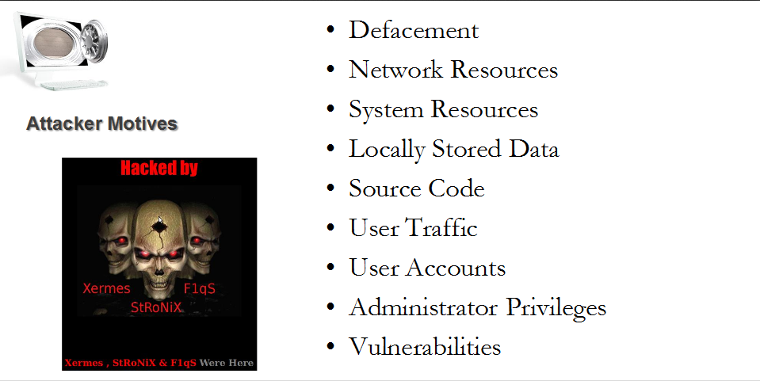
Attacks

Slide 5
Types of Attacks
Attacks on the web server
Attacks on the web client
Attacks on the web application
Attacks on the web user
Attacks on the network

Slide 6
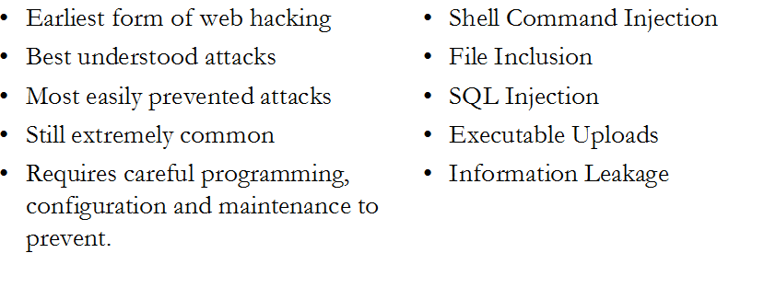
Server Attacks

Slide 7
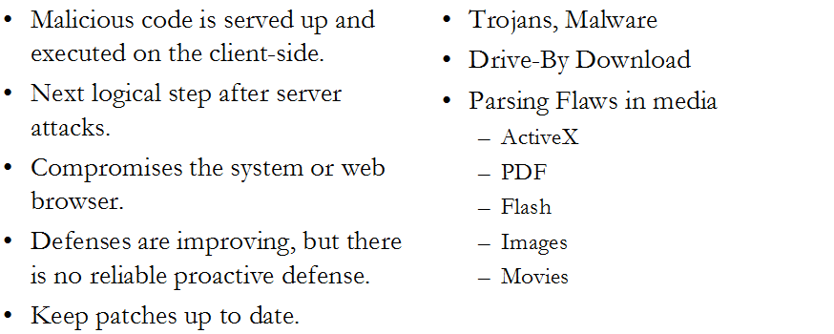
Client Attacks

Slide 8
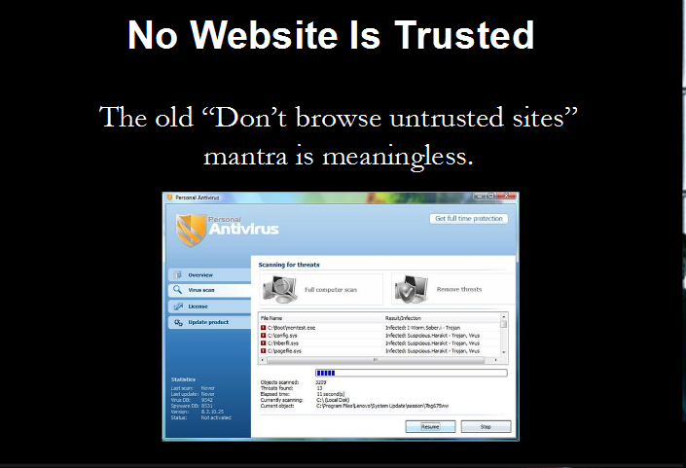
NO WEBSITE IS TO BE TRUSTED

Slide 9
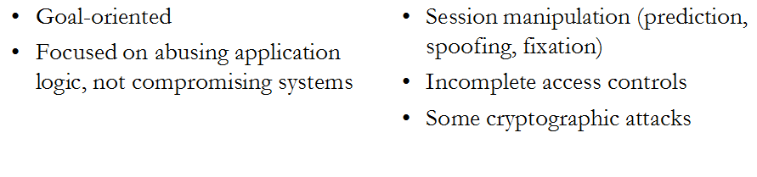
Application Attacks

Slide 10
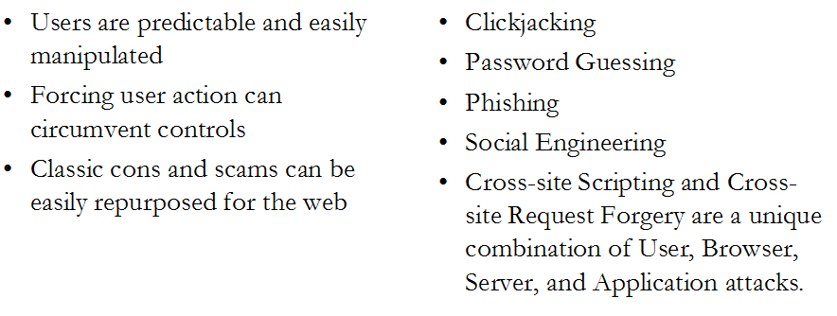
User Attacks

Slide 11
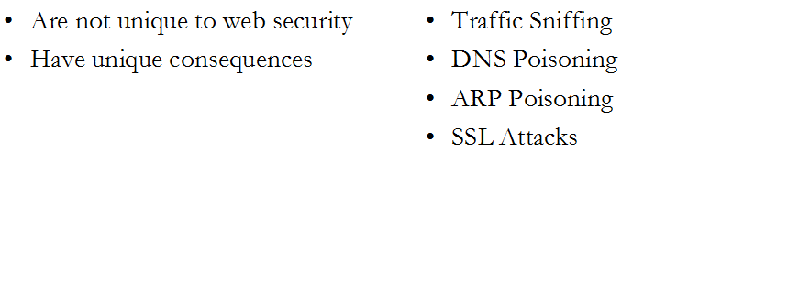
Network Attacks

Slide 12
Rule I
Never trust the client, the server, or the network
All inputs must be validated. All interactions with other parties must be assumed to be malicious until proven otherwise

Slide 13
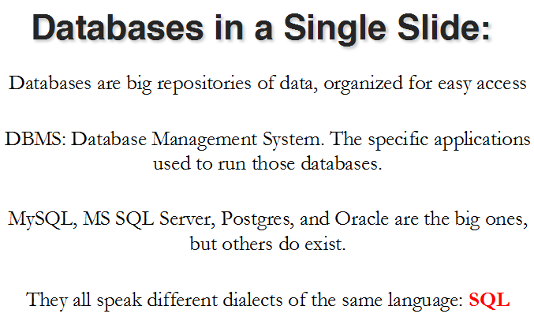
SQL Injection

Slide 14
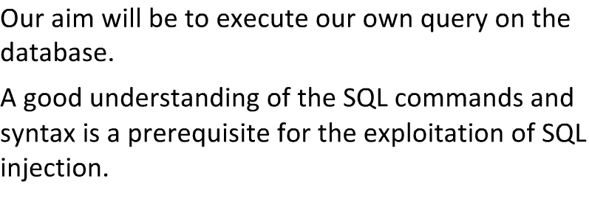
Goal of SQL Injection

Slide 15
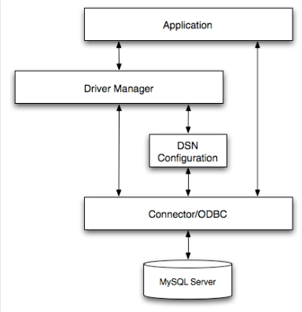
Injection Flow

Slide 16
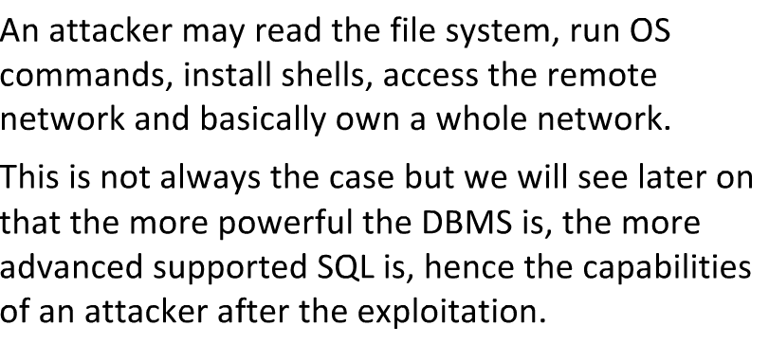
Dangers of SQL Injection

Slide 17
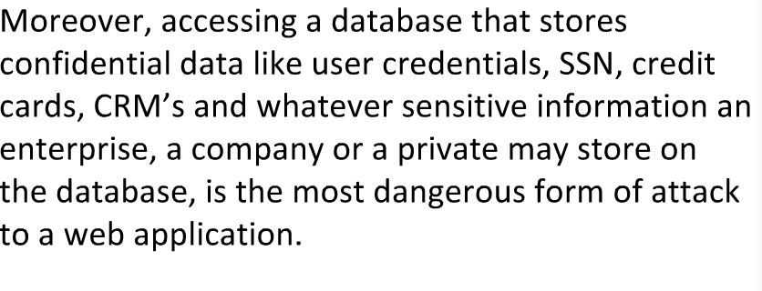
More Dangers

Slide 18
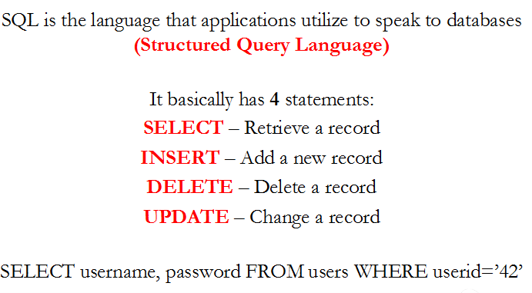
SQL

Slide 19
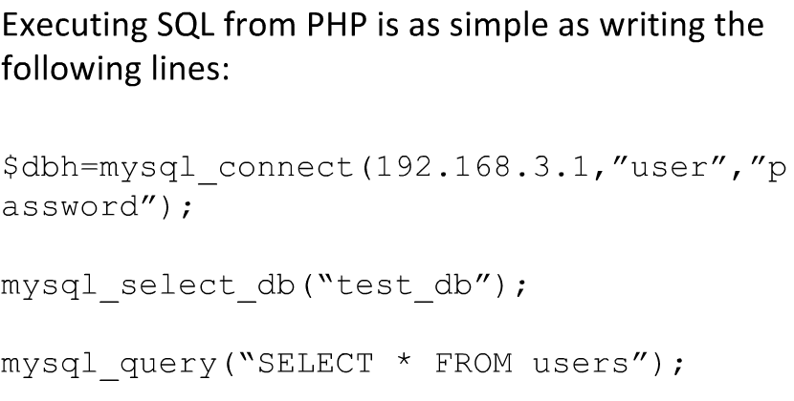
SQL Examples

Slide 20
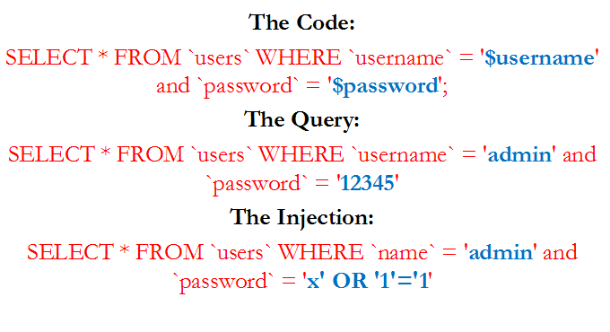
SQL in a Single Slide

Slide 21
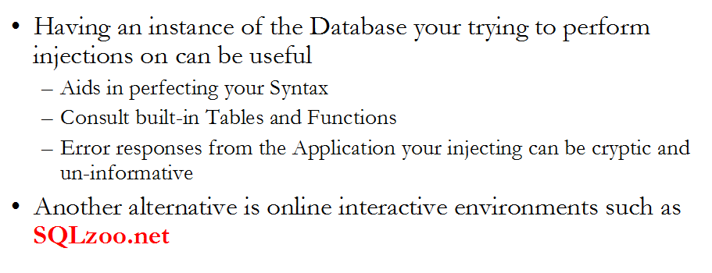
Recommendations

Slide 22
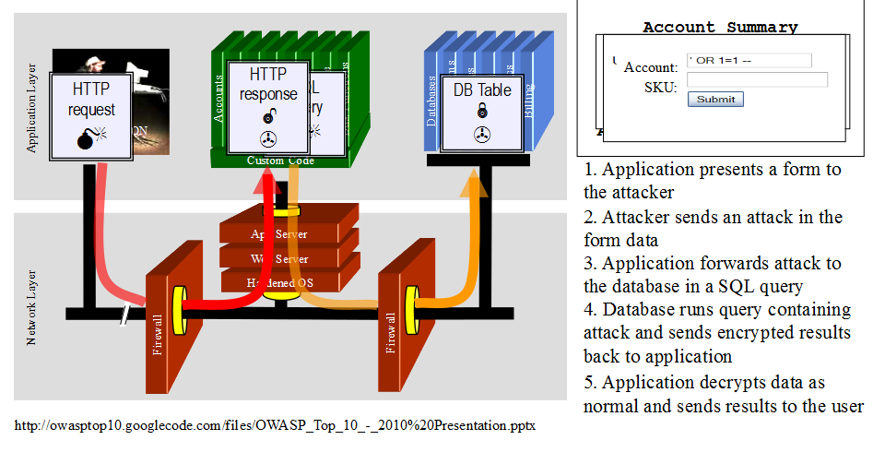
SQL INJECTION ILLUSTRATED

Slide 23
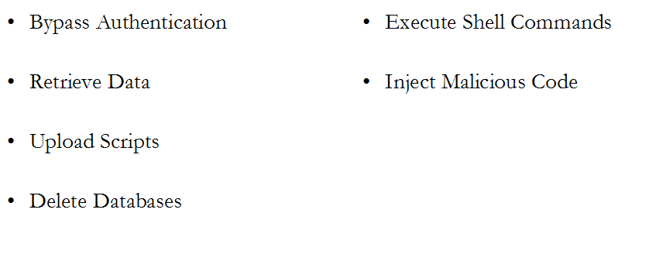
Things We Can do

Slide 24
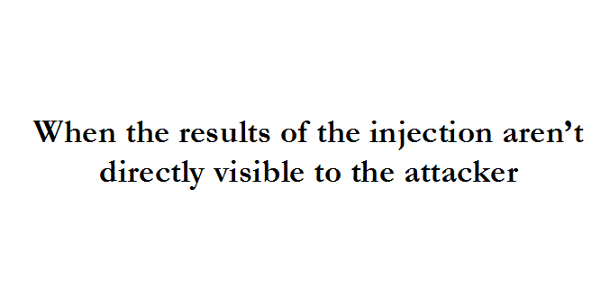
Blind SQL

Slide 25
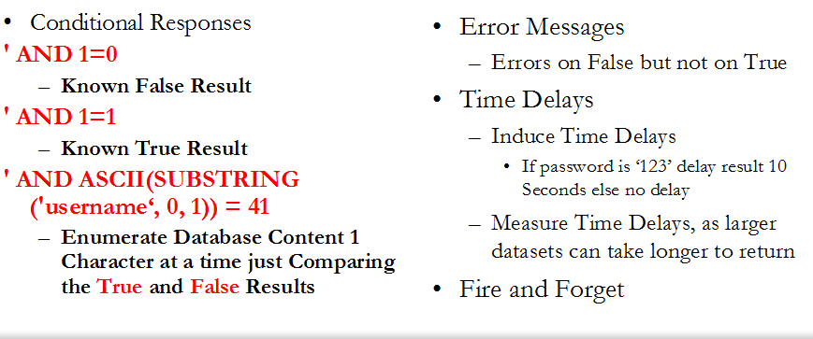
4 BASIC APPROACHES

Slide 26
LAB – SQL INJECTION
Hand Out lab
Hack me Lab
Senario 172

Slide 27
XSS Scripting
Modifying the parts of a targeted web page in order to inject executable code or content.
Generally implies abusing some combination of client side scripting languages, document object and same origin

Slide 28
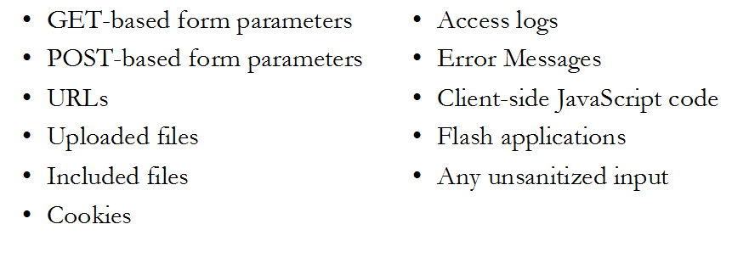
Where do find it ??

Slide 29
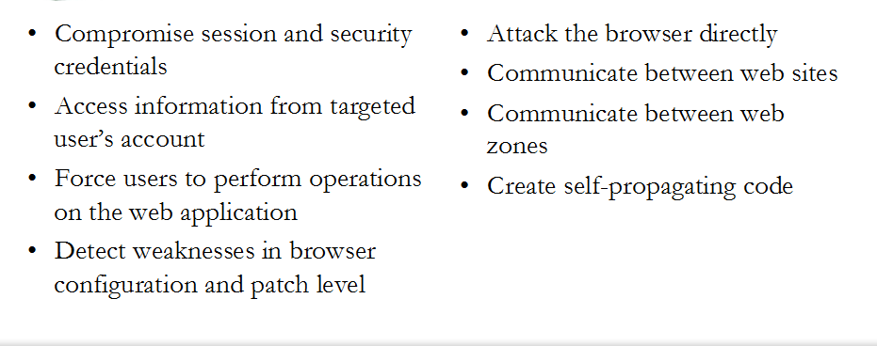
What can you do ??

Slide 30
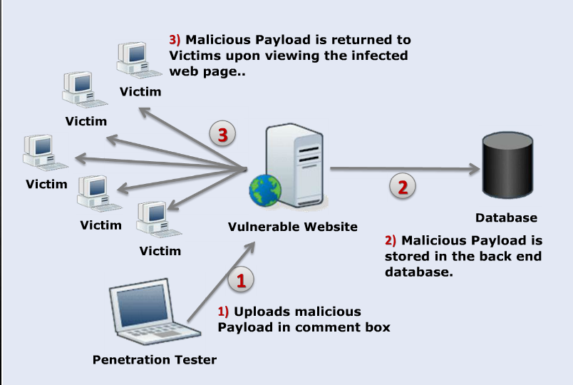
Persistent XSS

Slide 31
Summary Persistent
Persistent XSS attacks are when the payload is sent to the web server and stored/
This is why it is call persistent, because the payload is stored on the web server and can be displayed to any victim who views it.
It is one of the most dangerous forms of XSS because of single target, the attacker now has multiple targets from a single attack.
Prime vectors for this attack would be forms that submit content to the web server and then display that content back to the user.
Elements such as – comment boxes, user profiles and forums are susceptible to a persistent XSS Attack

Slide 32
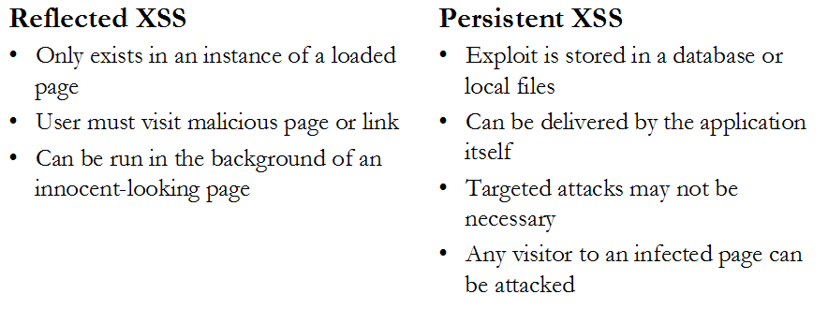
Exploiting XSS

Slide 33
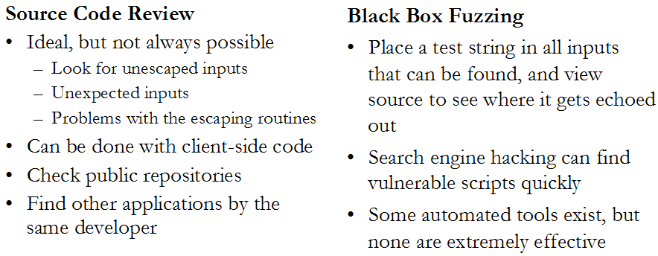
Finding XSS Scripting

Slide 34
Lets do – SQL Injection
1. Go to - https://hack.me/
Create a User ID
Sign-in
Go to
SQL injections - Bypassing authentication - Easy

Slide 35
Lets do – XSS Scripting Lab
1. Go to - https://hack.me/
Create a User ID
Sign-in
Go to Foo Radio
Create a another User ID
Determine if the Web applications is susceptible to XSS.
Hint - Find an input Screen
try entering scripting code
<h1> Hello </h1>
6. Once you round it try an alert Script:
<script>alert("Hello"); </script>

